Slide 1
DATA STRUCTURE
JAVA IMPLEMENTATION

Slide 2
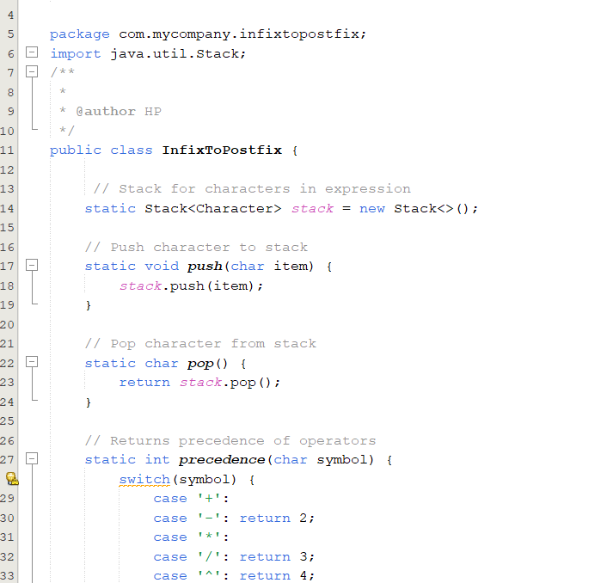
STACK(THE CONVERSION AND EVALUATION OF INFIX TO POSTFIX).
Before converting infix to postfix java.util.Stack class has to be imported in order to use some features.
Just like a scanner class is created a stack class is also created. Then we create a method that accepts item as the parameter , what the method does is to push the top item to the stack. Another method is also created called pop which returns the top item from the stack .
A method for precedence is also created to check which operator has a higher precedence

Slide 3
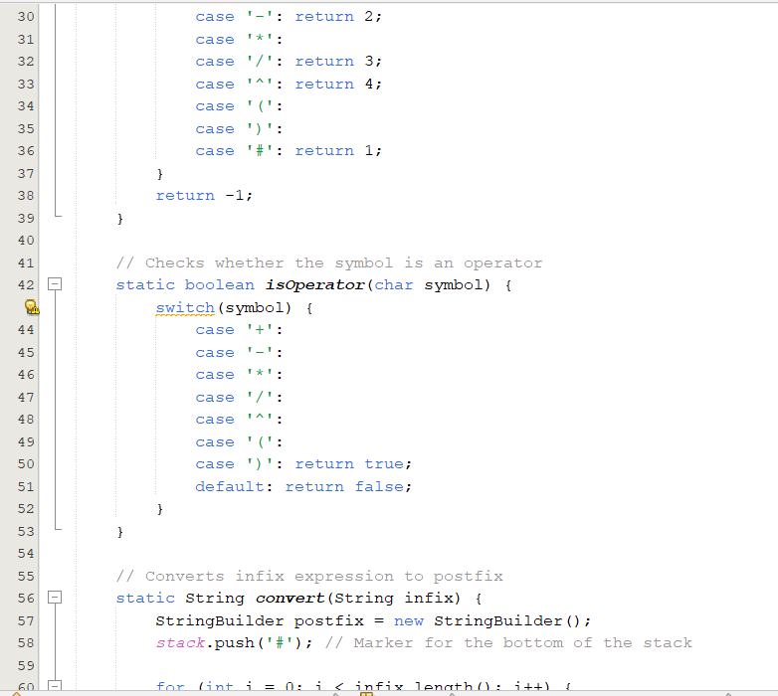
If it gets to the last case of # it still returns 1 the # acts as a sentinel so the stack is not left empty then if after checking all the operators and it is still not in the cases it returns -1. An operator method is also created to check for the operator if it is among the operator listed it return true else it returns false in the default case. Then one of the main methods which actually converts infix to postfix is defined, in this method a stringbuilder object which is flexible is created. Thereafter # is pushed to the stack and it is now the top item

Slide 4
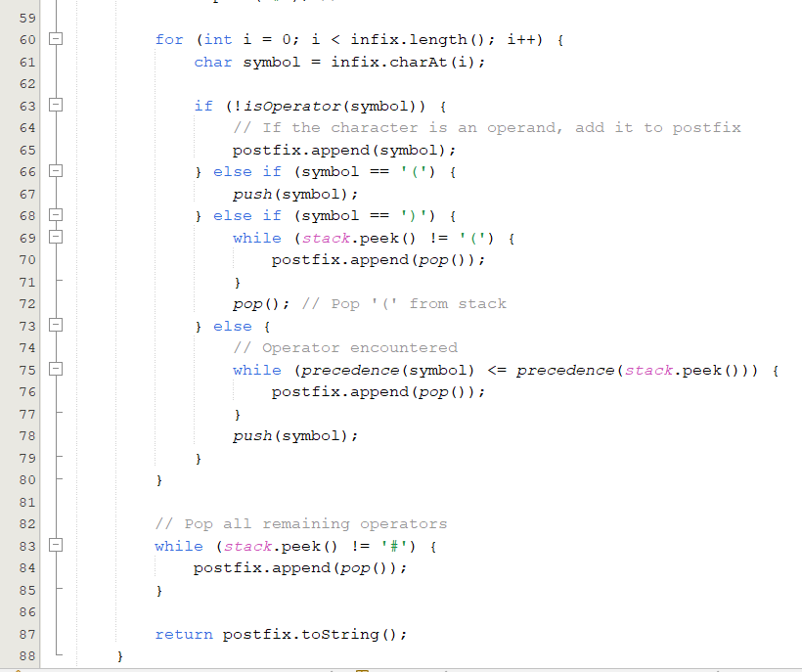
In this convert method a loop which runs until I < infix.length() then a variable is created which stores the index of a character in the infix. Then an if statement is created which checks the condition that as long as it is not an operator that means it is an operand it should append or add it to postfix. The first else if checks if it is the right parentheses if this is true it adds it to the top item in the stack if false it runs a while loop which runs as long as the top item is not equal to left parentheses, it pops what is in the stack and appends it to postfix. After the loop it pops the left parentheses as it is no longer needed. Then for the final else block it checks for the precedence of the operators if it is less than or equal to the operator at the top of the stack it removes the item at the top of the stack and appends it to postfix, but if the condition for the loop is not met we push the symbol to the top of the stack.

Slide 5
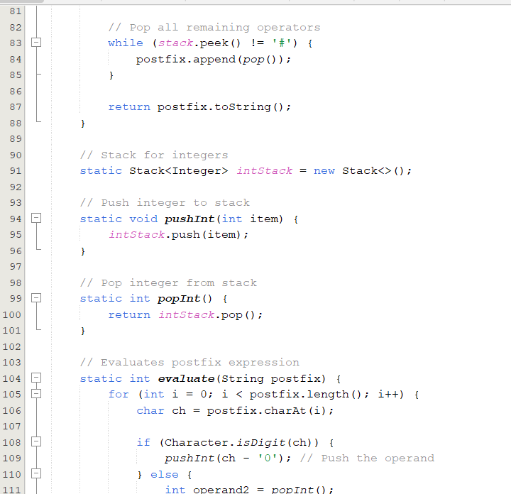
The loop then pops all the remaining operators until it gets to # and finally it returns the entire postfix.
A stack integer is then created which does basically the same operations like pop and push. Earlier we created a method for converting infix to postfix , but this time a method that evaluates the postfix so we can get the result. So a loop is created which evaluates till when i > postfix.length().
For the example when i = 0 the character- with the index position of 0 is assigned to ch, then it goes through the if statement to check if it is an operand if true the pushInt(ch – ‘0’) converts the charcter to the integer equivalent. I.e If we have 2 at index 0 of the postfix initially it is ‘2’ but after checking the condition and it is met it is converted to 2 and it is pushed .

Slide 6
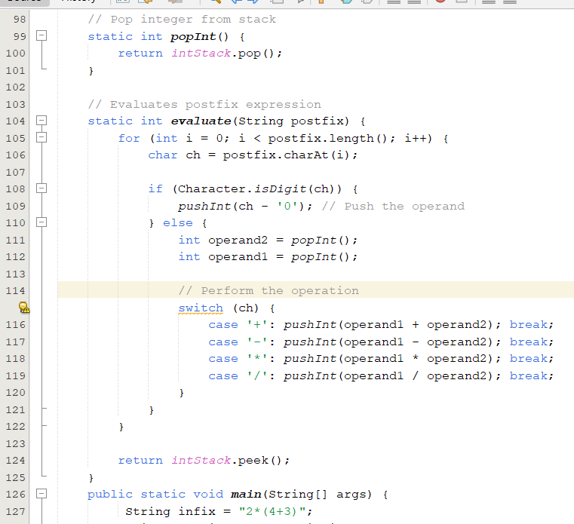
If it is not an operand but an operator the else block is executed which is removes the top item from the stack i.e. if we have 2 elements 1 and 3 and after checking the if statement it I not an operand it simply removes 1 and 3 from the stack and performs operations depending on the operator and adds a new item to the stack which is the result of the operation. Then it return the final result of the postfix

Slide 7
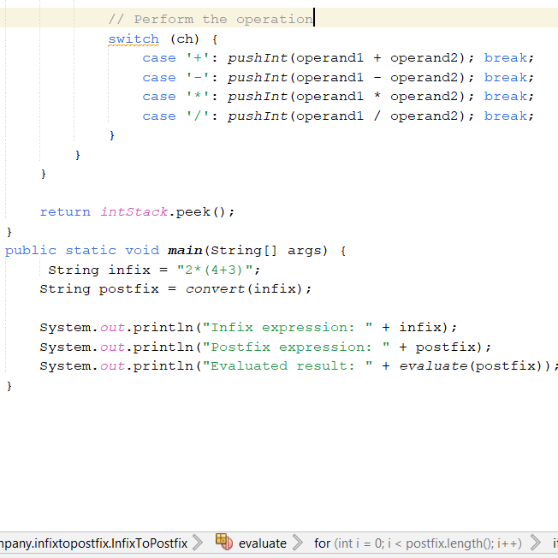
Then in the main method we declare a variable infix and set postfix to the method convert(infix). We can now print the infix, conversion of postfix and the result of the operation.

Slide 8
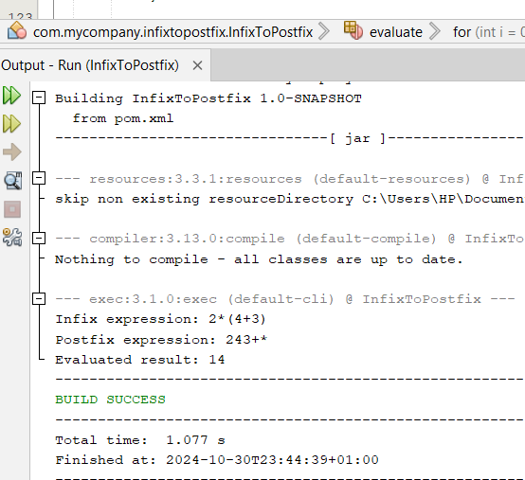
This is the output as seen in the picture the infix the postfix which was converted from the infix and the result.

Slide 9
THANK YOU

